Slide 1

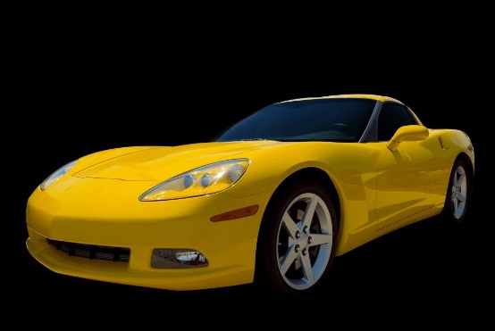
Penn Liberty Motors
Philadelphia, PA
www.libertymotors.biz

Slide 2
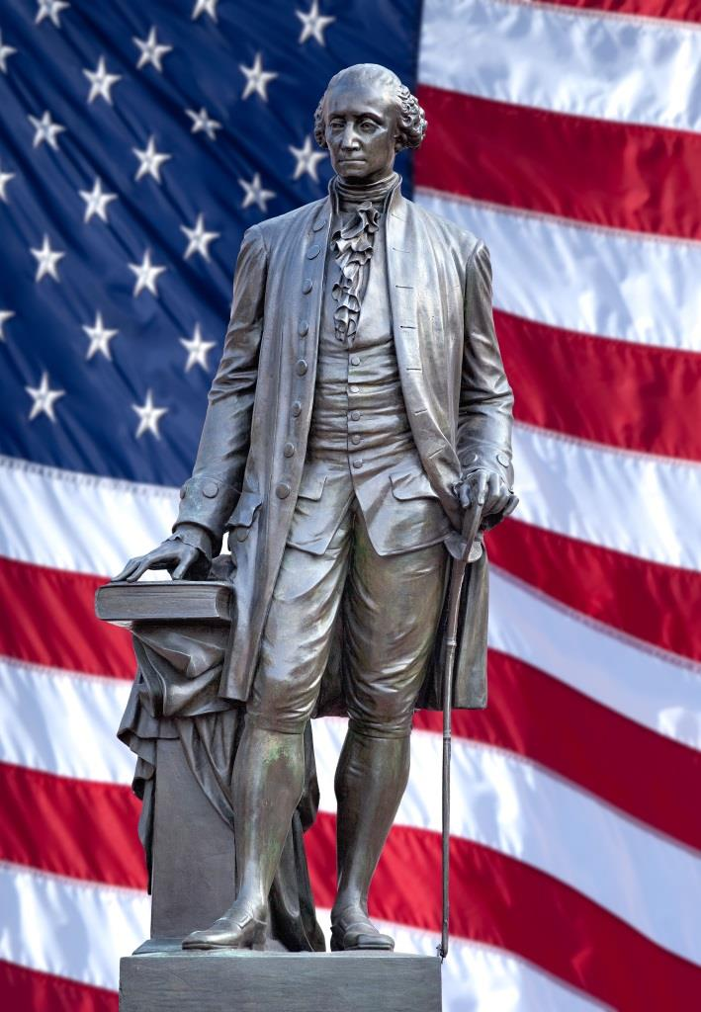
Our Location
Located in Center City Philadelphia
The city of our Founding Fathers
Convenient to:
Public transportation
Historic attractions
Plenty of free parking

Slide 3
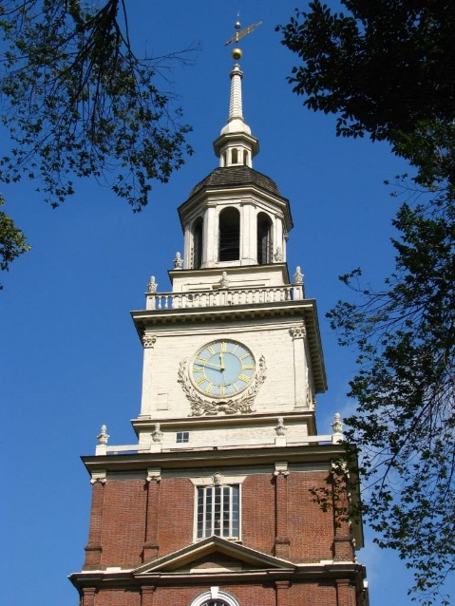
Independence National Park
Visit Cradle of Liberty
Tour Independence Hall
Visit Independence Living History Center

Slide 4
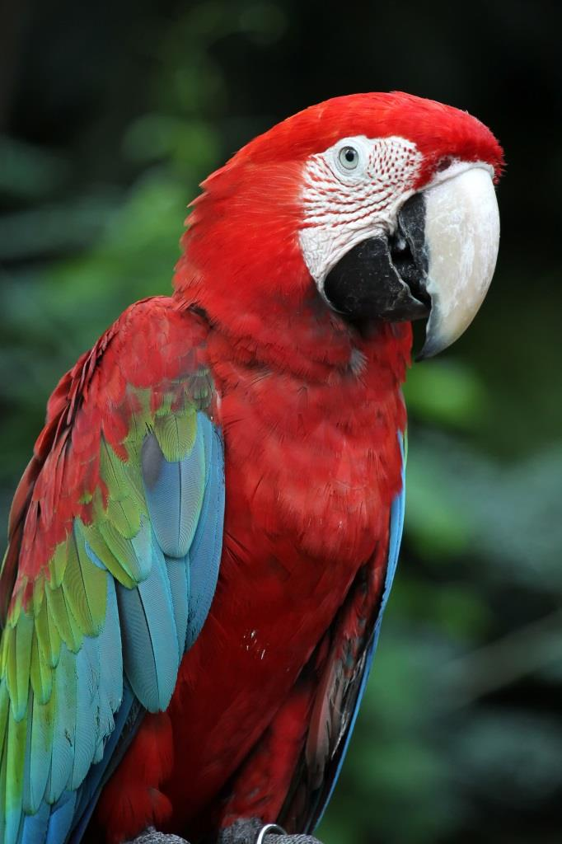
Philadelphia Zoo
America’s oldest zoo
Rides and attractions
Exotic animals
Conservation programs
Philadelphia Zoo

Slide 5
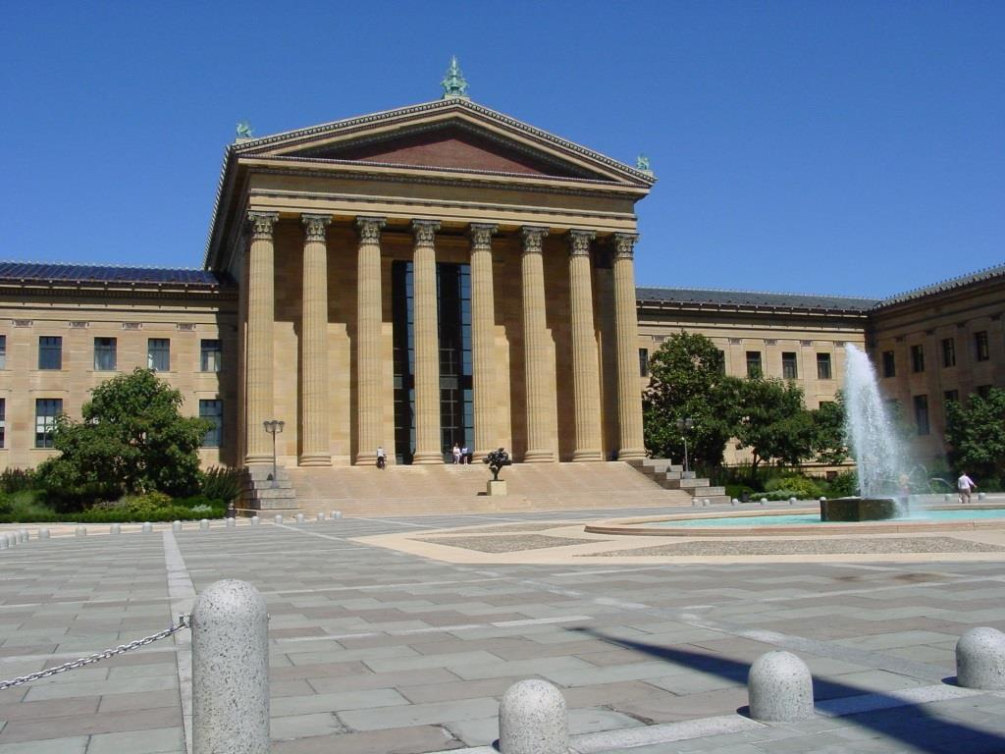
Philadelphia Museum of Art
Museum library
American crafts
European art
Architecture
Philadelphia Museum of Art

Slide 6

Rodin Museum
Works of Auguste Rodin
Original sketchbook
Spectacular gardens

Slide 7
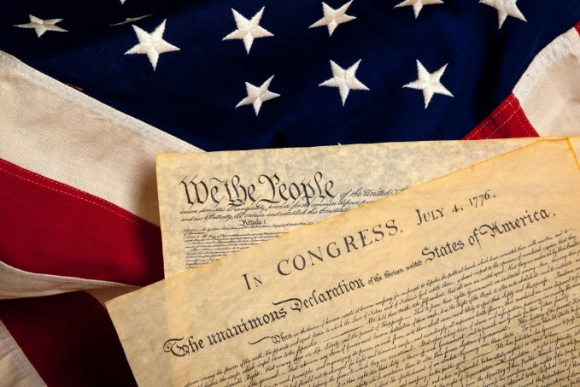
Discount Tickets
Penn Liberty Motors offers discount tickets
to these locations:
National Constitution Center
Independence National Park
United States Mint
Philadelphia Zoo
Contact Us

Slide 8
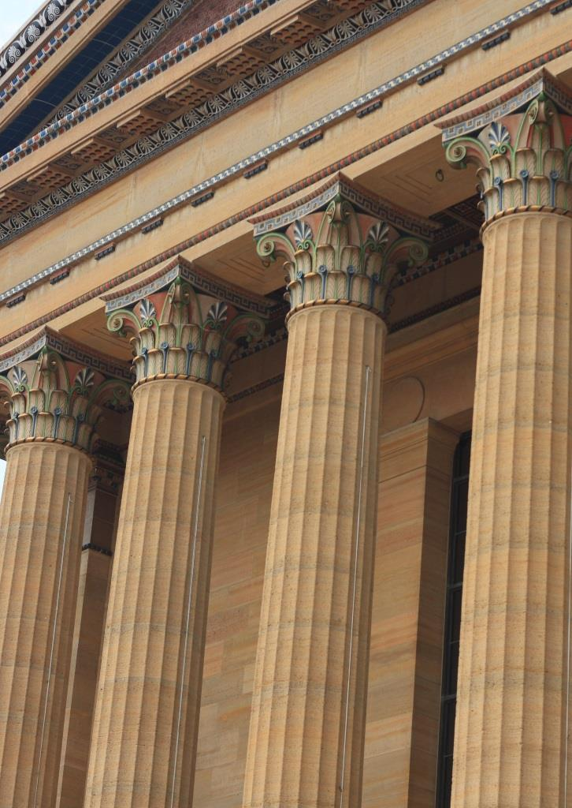
Convenient Location
Located in the cultural area of the city
Convenient to
Public transportation
Museums
Exhibitions
Plenty of free parking

Slide 9

Treat Yourself to a New Sports Car
Penn Liberty Motors New Car Selections

Slide 10

Treat Yourself to a Sedan
Penn Liberty Motors New Car Selections

